Slide 1


CLC training session 1:
Why the CLC is a good alternative to predatory loans
Notes:
What we will cover:
-the problem with payday loans
-why CLC Affordable Loan Program was created and why it is needed
-the Theory of Change and how the CLC program helps workers, employers and communities
-presenting the features and benefits of the CLC program to various audiences and stakeholders
-Questions and Answers

Slide 2
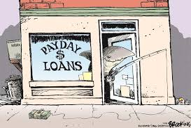
Understanding the Problem:
Expensive Predatory Loans targeting unsophisticated borrowers

Slide 3
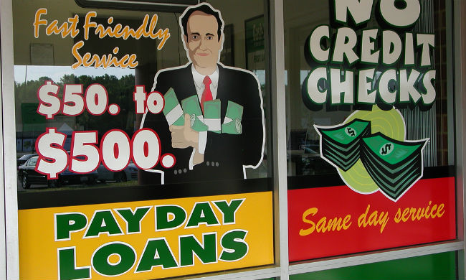
Predatory Financial Practices:
A National Issue
12 million people get payday loans annually
$27 billion in annual loan volume
High cost online lenders often manage to circumvent applicable state regulation.

Slide 4

Predatory Financial Practices:
A National Issue
The state laws that govern installment loans have received little attention in the past decades. In 1978, the Supreme Court ruled that banks that issue credit cards—the biggest source of small dollar credit today—could generally ignore state rate caps.

Slide 5
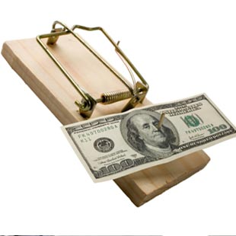
Predatory Financial Practices:
A National Issue
Prices for deep subprime loans often reach levels that are far higher than necessary to ensure availability of credit. When combined with unusually long repayment terms or schemes that encourage borrowers to
refinance loans, high
interest rates can lead
to extended and
unmanageable debt.

Slide 6

Predatory Financial Practices:
A National Issue
Some jurisdictions put caps on interest rates but by calling penalties for borrowing ‘fees’ rather than interest, some lenders are able to charge more than what the law is intending to allow.
                -Source: Ctr for Responsible Lending
                Most payday loan borrowers pay more in fees than they borrow in credit.
                -Source: Pew Charitable Trusts

Slide 7

Predatory Financial Practices:
A National Issue
The typical payday borrower remains in payday loan debt for an average 212 days of the year after a two-week loan.
The “churning” of existing borrowers’ loans every two weeks accounts for three-fourths of all payday loan volume.
    -

Slide 8

Predatory Financial Practices:
A National Issue
Repeated payday and title loans result in $9 billion in fees each year.
-Source: Pew Charitable Trusts

Slide 9

Predatory Financial Practices:
A National Issue
The average payday borrower has nine transactions per year.
-Source: Ctr for Responsible Lending

Slide 10

Predatory Financial Practices:
A National Issue
In the years that followed the 1978
Supreme Court ruling, many states
carved out exemptions from their
usury laws for payday lending,
short-term single-payment loans
with annual percentage rates (APRs)
averaging 391%. Between payday
loans and credit cards, the impact of
state installment loan laws receded
into the background.

Slide 11
Predatory Financial Practices:
A National Issue
Notes:
Payday loan are only legal in 36 states. And, this is brick and mortar only! “one type of chain vs all chains”

Slide 12
Predatory Financial Practices
Affect Neighborhoods
RACIAL INEQUITY: A 2009 study of Payday Lending in CA by Center for Responsible Lending found that:
“Even after controlling for income and a variety of other factors, payday lenders are 2.4 times more concentrated in African American and Latino communities.”

Slide 13

Predatory Financial Practices
Affect Neighborhoods
Race and ethnicity play a far less prominent role in the location of mainstream financial institutions, such as bank branches. While race and ethnicity account for over half of the variation in payday lender location explained by neighborhood factors, they explain only one percent of the variation in bank
branch locations.

Slide 14
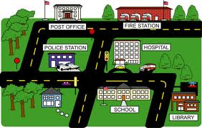
Predatory Financial Practices
Affect Neighborhoods
On average, controlling for a variety of relevant factors, the nearest payday lender is almost
twice as close
to the center of an
African American
or Latino
neighborhood
as a largely white
neighborhood.

Slide 15
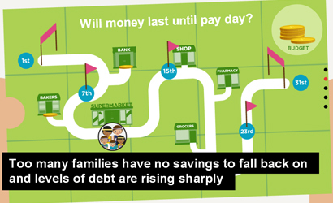
Predatory Financial Practices
Affect the Workplace
47% of Americans surveyed said they do not have $400 available for an emergency
-Source: 2013 Report published by the Federal Reserve Board

Slide 16
Predatory Financial Practices
Affect the workplace
Eighty-three percent of human resources professionals reported that financial stress is having a negative impact on employee work performance in their organization.
-Source: Society for Human Resource Management, SHRM Research Spotlight: Financial Education Initiatives in the Workplace, 2012

Slide 17

Predatory Financial Practices
Affect the workplace
24% of employees admitted their personal finances have been a distraction at work
-Source: PricewaterhouseCoopers, Employee Financial Wellness Survey, April, 2014

Slide 18

Predatory Financial Practices
Affect the workplace
Employees aren’t getting financial empowerment from their employers.
Despite the challenges financial distress presents for employee engagement, only 6% of employees strongly agreed that their organization provides training or resources to help them manage their finances more effectively.
-Source: Jennifer Robison, “The Business Case for Wellbeing,”
Gallup Business Journal, June 9, 2010

Slide 19
Predatory Financial Practices
Affect Families
More than 50 percent of predatory loan recipient defaulted on their loans, placing their existing bank accounts at risk.
Borrowers also could have their debts sold
to a collection agency
or face court action.
-source: American Progress
Notes:
More than 50% default – ruins credit score, endangers bank account.

Slide 20
Predatory Financial Practices
Affect Families
90% of the payday lending business is generated by borrowers with five or more loans per year, and over 60% of business is generated by borrowers with 12 or more loans per year.
-source: Center for Responsible Lending
Notes:
More than 50% default – ruins credit score, endangers bank account.

Slide 21
Predatory Financial Practices
Affect Families
Just 14 percent of borrowers say they can afford to repay an average payday loan out of their monthly budget.
-Souce: Pew Charitable Trusts
Notes:
More than 50% default – ruins credit score, endangers bank account.

Slide 22

Predatory Financial Practices
Affect Families
HEALTH:
The impetus
for a FIRST
payday loan is
often a medical
expense.

Slide 23

Predatory Financial Practices
Affect Families
The costs of churning payday loans can keep families from affording medical expenses (like the mom who
couldn’t buy the
inhaler and the
nebulizer from
the same
paycheck
and still make
her loan payment)

Slide 24

Predatory Financial Practices
Affect Families
Financial distress leads to
physical distress, anxiety
and depression.

Slide 25
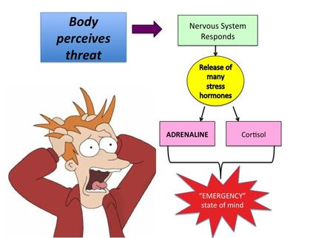
Predatory Financial Practices
Affect Families

Slide 26
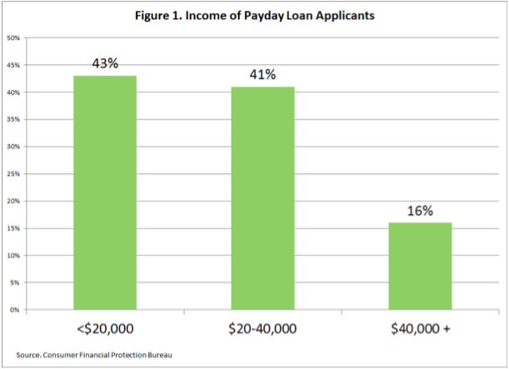
Payday Borrowers By Income
Payday Loan Borrowers By Income
Notes:
Who are payday borrowers?
43 % of payday borrowers earn <$20,000/yr
41 % earn $20,000-$40,000/yr
16 % earn over $40,000/yr

Slide 27
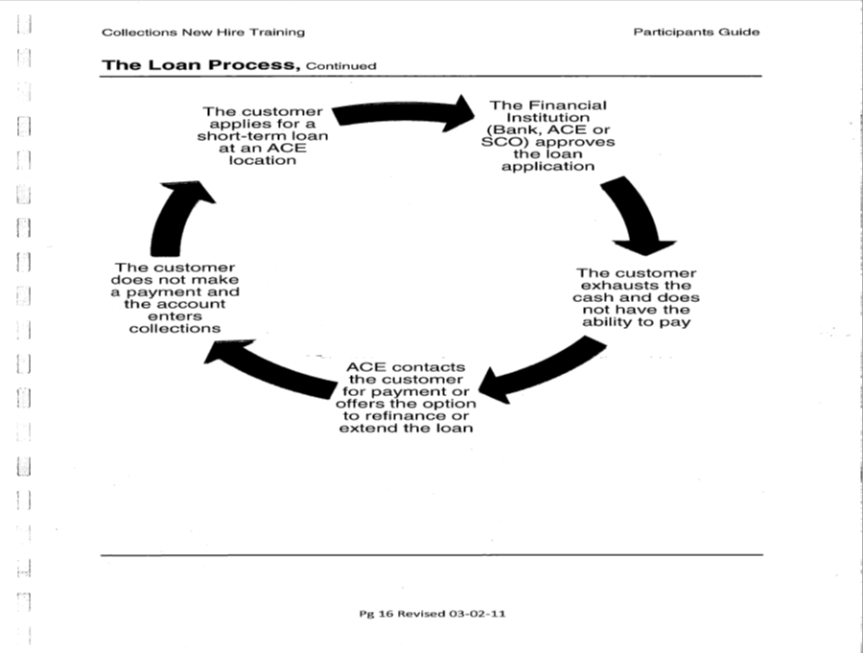

Slide 28

THE PROBLEM:
PAYDAY & AUTO TITLE LOANS
Texas
in 2018
2,552
Payday and Auto Title Lenders
$1.59 Billion
Fees charged Texans in 2016
32,077
Cars repossessed in Texas in 2016
$ 5.2 Billion
The industry of payday and auto-title lending in our state
Our Community
Millions of dollars are stripped from our community every year!
550
Payday & Auto Title lenders
$244
Million
Fees charged
6,096
Cars repossessed
A $1,000 loan
costs a borrower in Houston
664% APR
EMPLOYEES’
FINANCIAL STRESS
Houston MSA in 2016
Sources: Office of Consumer Credit Commissioner website

Slide 29

Employees want more financial security
40% of employees reported that they want help in achieving financial security Source: MetLife,10th Annual Study of Employee Benefits Trends: Seeing Opportunity in Shifting Tides, 2012

Slide 30
Employees want more financial security
Only 6% of employees strongly agreed that their organization provides training or resources to help them manage their finances more effectively.
-Source: Jennifer Robison, “The Business Case for Wellbeing,”
Gallup Business Journal, June 9, 2010

Slide 31

Solution: Community Loan Center
Notes:
The terms of the CLC loans are $1,000 loan maximum or up to half of the employee’s monthly gross pay with up to one year loan term. The interest rate is 18% and there is a $20 loan origination fee. There are no prepayment penalties, CLC reports to credit bureaus so with timely loan payments, borrowers can improve their credit score. Loan repayment for a $1,000 loan is $23.38/week or about $96/mo. Underwriting is limited in order to offer an application process that is comparable to the loan store products.

Slide 32

Community Loan Center
Community Loan Center
Alternative: Market-Based Approach
  Fairly priced small-dollar loans with reasonable terms
  Direct competition to high costs lenders
  Employer based loan to workers
Notes:
The Community Loan Center network was created to compete directly with payday and car title lenders by offering affordable credit and structured to support repayment. To create this new loan program, an advisory committee of experts in financial services, non profit management and law was assembled to provide guidance in program design.
As a result, the CLC program was created which provides a fairly priced small-dollar consumer loan alternative to much higher priced options. CLC loan program was designed to be administered by nonprofits as a sustainable social enterprise with the potential to outgrow the need for subsidy by generating revenue to the non profit. Finally, the CLC loan program was designed to be replicated across the state and beyond.

Slide 33

Small Dollar Loans Comparison
 | Affordable Small Dollar Loan | Payday Loans
Loan Amount | $1,000 | $1,000
Administrative Fee | $20 | $0
Term | 12 months | 14 to 30 days
Interest Rate | 18% | n/a
Financial Fee | n/a | $300 * / $600**
Total Interest/Fees | $122.16 | $900
Annual Percentage Rate | 21.8321% | 782.14%
Monthly Payment | $93.51 | $1,300 due in 14 days
*1st 14 day fee is $300, if renewed an additional $300 fee is required. **If loan is extended (as indicated by research) two times.
Notes:
According to a payday lending study conducted by Pew Charitable Trusts, only 14 % of payday loan borrowers can afford enough out of their monthly budgets to repay an average payday loan.
The federal Consumer Finance Protection Bureau recently found that 80% of payday loan borrowers are unable to repay loan and have to refinance

Slide 34

Community Loan Center
CLC loans can help reduce employee absenteeism (missing work to refinance payday loans) plus presenteeism (dealing with personal problems on the job which are unrelated to work like calls from creditors,
returned checks, etc.).
This helps lead to increased
job performance.

Slide 35
Community Loan Center
Employer Based
  Payroll Deduction
  No storefront reduces costs of operations
  No cost to employers
  Marketed as and
  Employee Benefit
Notes:
The CLC program is Employer Based. Each CLC affiliate recruits local employers into the program who offer the CLC loans to their employers, at no cost to the employer. Loans are repaid through payroll deduction so loan payments are made whenever the borrower is paid. To offer the low interest rate of 18%, operation costs are reduced by automation and no loan stores. Improved efficiencies result from a website for loan origination, which is outsourced along with loan servicing.
The CLC program is Nonprofit driven. Each CLC affiliate solicits their own loan capital from grants, program related investments from foundations, or other low cost debt financing. Bank investors should be eligible for credit under the Community Reinvestment Act.

Slide 36
Community Loan Center Terms
$1,000 Loan Maximum
  Or up to half of borrower’s monthly gross pay
  One Year Loan term
18% Interest (21.83% APR)
$20 loan origination fee
Relaxed underwriting
No collateral
No Prepayment Penalties
Repayments $23.38/week or $94/month
Notes:
The terms of the CLC loans are $1,000 loan maximum or up to half of the employee’s monthly gross pay with up to one year loan term. The interest rate is 18% and there is a $20 loan origination fee. There are no prepayment penalties, CLC reports to credit bureaus so with timely loan payments, borrowers can improve their credit score. Loan repayment for a $1,000 loan is $23.38/week or about $96/mo. Underwriting is limited in order to offer an application process that is comparable to the loan store products.

Slide 37

Community Loan Center
CLC loans can reduce the number of employee requests for paycheck advance or loans against retirement funds.

Slide 38
Community Loan Center
Improved Efficiencies
  Online proprietary interface for loan origination
  Outsource Loan Processing
  Outsource Loan Servicing
Notes:
The CLC program is Employer Based. Each CLC affiliate recruits local employers into the program who offer the CLC loans to their employers, at no cost to the employer. Loans are repaid through payroll deduction so loan payments are made whenever the borrower is paid. To offer the low interest rate of 18%, operation costs are reduced by automation and no loan stores. Improved efficiencies result from a website for loan origination, which is outsourced along with loan servicing.
The CLC program is Nonprofit driven. Each CLC affiliate solicits their own loan capital from grants, program related investments from foundations, or other low cost debt financing. Bank investors should be eligible for credit under the Community Reinvestment Act.

Slide 39
Community Loan Center
Sustainable and Scalable
  Can outgrow the need for subsidy and generate revenues
  Designed to be
  replicated
Notes:
The Community Loan Center network was created to compete directly with payday and car title lenders by offering affordable credit and structured to support repayment. To create this new loan program, an advisory committee of experts in financial services, non profit management and law was assembled to provide guidance in program design.
As a result, the CLC program was created which provides a fairly priced small-dollar consumer loan alternative to much higher priced options. CLC loan program was designed to be administered by nonprofits as a sustainable social enterprise with the potential to outgrow the need for subsidy by generating revenue to the non profit. Finally, the CLC loan program was designed to be replicated across the state and beyond.

Slide 40
Community Loan Center
Nonprofit driven
  Grants, Program Related Investments, low cost debt financing
  CLC loans help Bank Investors comply Community Reinvestment Act obligations
Notes:
The CLC program is Employer Based. Each CLC affiliate recruits local employers into the program who offer the CLC loans to their employers, at no cost to the employer. Loans are repaid through payroll deduction so loan payments are made whenever the borrower is paid. To offer the low interest rate of 18%, operation costs are reduced by automation and no loan stores. Improved efficiencies result from a website for loan origination, which is outsourced along with loan servicing.
The CLC program is Nonprofit driven. Each CLC affiliate solicits their own loan capital from grants, program related investments from foundations, or other low cost debt financing. Bank investors should be eligible for credit under the Community Reinvestment Act.

Slide 41

CLC is a high quality small-dollar loan program
The loan is made with a high confidence in the borrower's ability to repay
The loan is structured to support repayment
The loan is priced to align profitability for the provider with success for the borrower

Slide 42
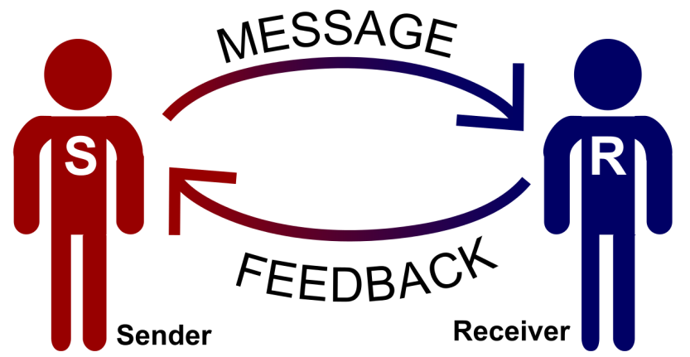
CLC is a high quality small-dollar loan program
The loan program creates opportunities for upward mobility and greater financial health
The lender has transparent marketing, communications and disclosures

Slide 43

CLC is a high quality small-dollar loan program
The loan is accessible and convenient
The lender provides support and rights for borrowers

Slide 44


Who We Are
Notes:
CLC created by the Rio Grande Valley Multibank, CDFI founded 1995
Consulted with experts to create affordable small-dollar consumer loan program
and comprised of 9 bank investors who offer a range of financial services to benefit lower income borrowers and community groups in South Texas.
Pilot program of employer based, affordable payday loan alternative
TCC network administrator to rollout the CLC statewide
TCC is nonprofit created in 2004 by TACDC to provide specialized loan products to under-served Texas communities to enhance the quality of life of low-to-moderate income persons.

Slide 45
The Community Loan Center is a subsidiary of the Rio Grande Valley Multibank CDFI (RGVMB). RGVMB was founded in 1995 by local investor stockholder banks.

Slide 46
What We Do
Rio Grande Valley CLC
Owner and Franchisor of CLC Program
Contracted to Originate and Service All Loans
Maintains CLC Software and Intellectual Property
Community Loan Center of America
Recruit, train, and provide technical assistance, marketing support, capital loans and development assistance to new Local Lenders
CLC Subfranchisor
CLC Local Lender in unserved Texas markets
Local CLC Lenders
Become a Licensed Lender in your state
Raise seed capital for your CLC loan program
Recruit and train Local Employers to Participate in CLC loan program
Offer CLC borrowers free, financial literacy opportunities
Report borrower credit history to at least one credit bureau

Slide 47
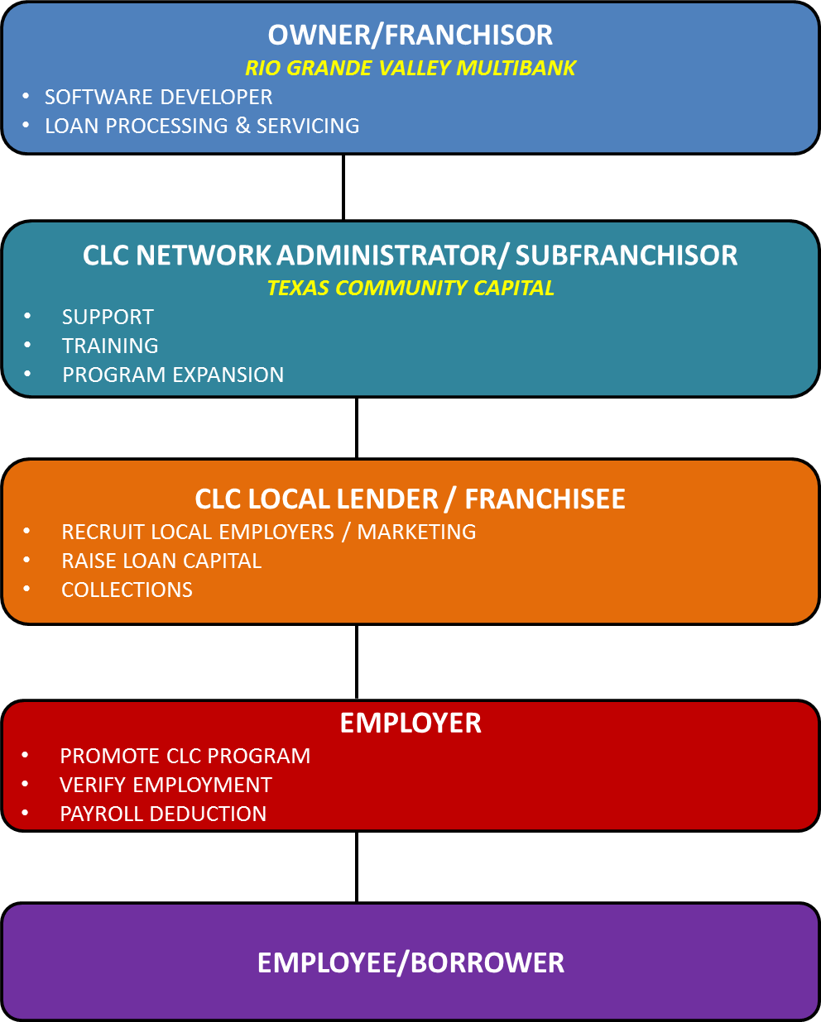

Slide 48
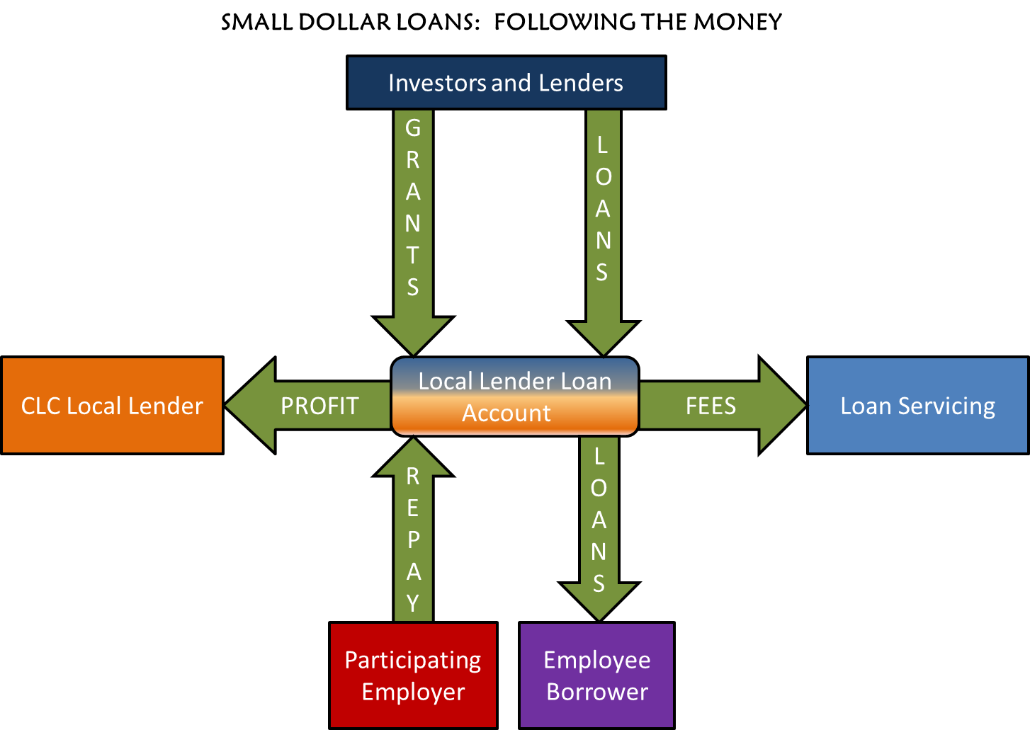

Slide 49
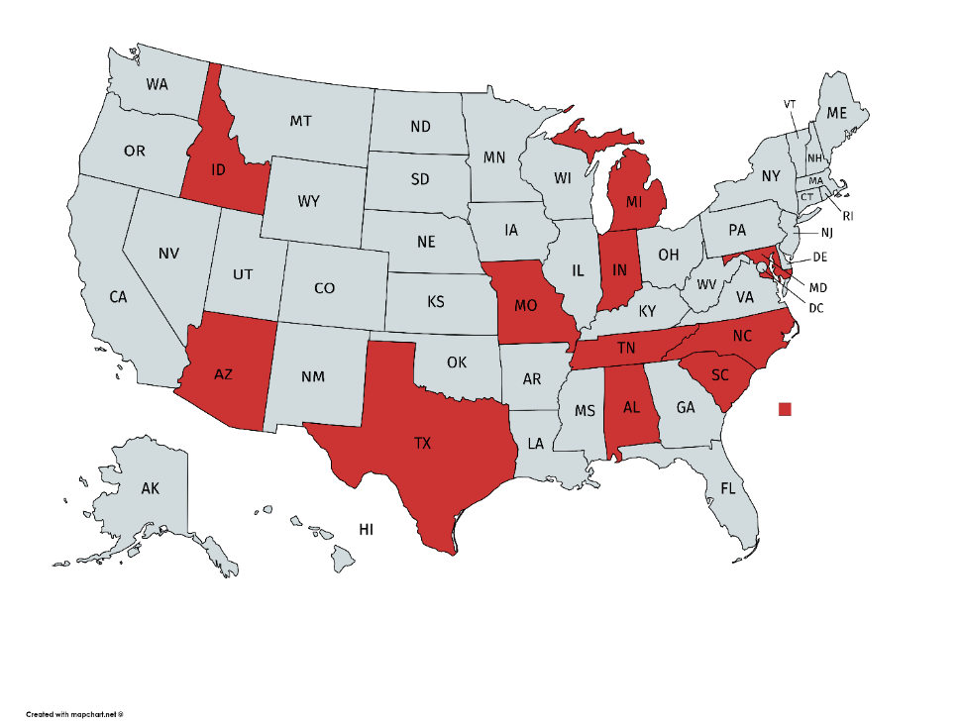
Community Loan Center locations
Brownsville, TX
Dallas, TX
Austin, TX
Bryan/College Station, TX
Houston, TX
Laredo, TX
Kilgore, TX
San Antonio, TX
Fort Wayne, IN
Lafayette, IN
Baltimore, MD
St. Louis, MO
Raleigh/Durham, NC
Chattanooga, TN
Pocatello, ID
Nashville, TN
Gary, IN
Flint, MI
Flagstaff, AZ
Birmingham, AL
Charleston, SC
Park Hills, MO

Slide 50
CLC Program Success
Over 64,000 CLC loans made to date
Active at over 200 employers covering over 110,000 employees (potential borrowers)
3 of the 11 largest American cities now offer the CLC loan program to their city employees
Default Rate: 4%
Saved borrowers over $42 million so far
Designed to show a profit with strong loan production and good management
Notes:
Refer to slide

